Slide 2
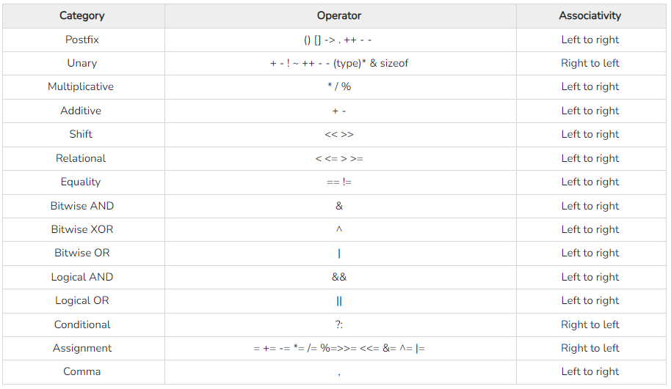

Slide 3
#include <stdio.h>
void main()
{
printf("value is = %d",(10++));
}

Slide 4
#include <stdio.h>
void main()
{
int x=10;
x+=(x++)+(++x)+x;
printf("%d",x);
}

Slide 5
#include <stdio.h>
int main()
{
int a = 1;
int b = 1;
int c = a || --b;
int d = a-- && --b;
printf("a = %d, b = %d, c = %d, d = %d", a, b, c, d);
return 0;
}

Slide 6
#include <stdio.h>
int main()
{
printf("%d", 1 << 2 + 3 << 4);
return 0;
}

Slide 7
#include <stdio.h>
int main() {
int i = 1, 2, 3;
printf("%d", i);
return 0; }

Slide 8
#include<stdio.h>
int main(void)
{
int a = 1;
int b = 0;
b = a++ + a++;
printf("%d %d",a,b);
return 0;
}

Slide 9
#include<stdio.h>
int main()
{
int a = 2,b = 5;
a = a^b;
b = b^a;
printf("%d %d",a,b);
return 0;
}

Slide 10
#include <stdio.h>
int main()
{
int i = (1, 2, 3);
printf("%d", i);
return 0;
}

Slide 11
Assume that the size of an integer is 4 bytes, predict the output of following program.
#include <stdio.h>
int main()
{
int i = 12;
int j = sizeof(i++);
printf("%d %d", i, j);
return 0;
}

Slide 12
#include <stdio.h>
int main()
{
int y = 0;
int x = (y != 0);
printf("%d", x);
return 0;
}

Slide 13
Assume sizeof character is 1 byte and sizeof integer is 4 bytes
#include <stdio.h>
int main()
{
printf("%d", sizeof(printf("jagadeesh")));
return 0;
}

Slide 14
#include<stdio.h>
int main()
{
printf("%d",printf("jagadeesh"));
return 0;
}

Slide 15
#include <stdio.h>
int main()
{
int i=3;
printf("%d", (++i)++);
return 0;
}

Slide 16
#include <stdio.h>
int main() {
int x = 10;
int y = 20;
x += (y += 10);
printf("%d %d", x, y);
return 0;
}

Slide 17
#include <stdio.h>
void main()
{
int a=10,b=2,x=0;
x=a+b*a+10/2*a;
printf("value is =%d",x);
}

Slide 18
#include <stdio.h>
void main()
{
unsigned short var='B’;
var+=2;
var++;
printf("var : %c , %d ", var,var); }

Slide 19
#include <stdio.h>
void main()
{
int x=(20 || 40 ) && (10);
printf("x= %d",x);
}

Slide 20
#include <stdio.h>
void main()
{
int x;
x= (printf("AA")||printf("BB"));
printf("%d",x);
printf("\n");
x= (printf("AA")&&printf("BB"));
printf("%d",x);
}

Slide 21
#include <stdio.h>
void main()
{
int a=3,b=2;
a=a==b==0;
printf("%d,%d",a,b);
}

Slide 22
#include <stdio.h>
int main()
{
char val=250;
int ans;
ans= val+ !val + ~val + ++val;
printf("%d",ans);
return 0;
}

Slide 23
#include <stdio.h>
int main()
{
int i=-1,j=-1,k=0,l=2,m;
m=i++&&j++&&k++||l++;
printf("%d %d %d %d %d",i,j,k,l,m);
return 0;
}

